Slide 1







































What PMs Need to Know about Voluntary Agricultural Districts
Copy/paste any of the icons below into your presentation. Please change color to white if using them on a dark background.
Jennifer A. Evans, PE
Leilani Paugh
September 13, 2023
Notes:
Recently we had a project that resulted in a condemnation of a VAD parcel. Unfortunately our screening processes had to resulted in identification of the VAD and ultimately we were in construction (after condemnation) when this issue was brought to NCDOT’s attention.

Slide 2
Other slide variations are available. Select Insert above and choose “new slide” to see all the options.
GOALS FOR TODAY’S PRESENTATION:
Provide PMs with a high-level awareness of Voluntary Agricultural District requirements and data sources so that they can:
Understand the basic requirements of VAD parcels and the NCDOT screening processes
Understand the data that is available now and the restrictions on available data in the past
Screen or flag older projects prior to right of way activities to ensure we are meeting the requirements for hearings prior to condemnation
Request assistance from Community Studies staff if there are concerns/questions
Request assistance from Public Involvement staff to coordinate on required VAD hearings

Slide 3
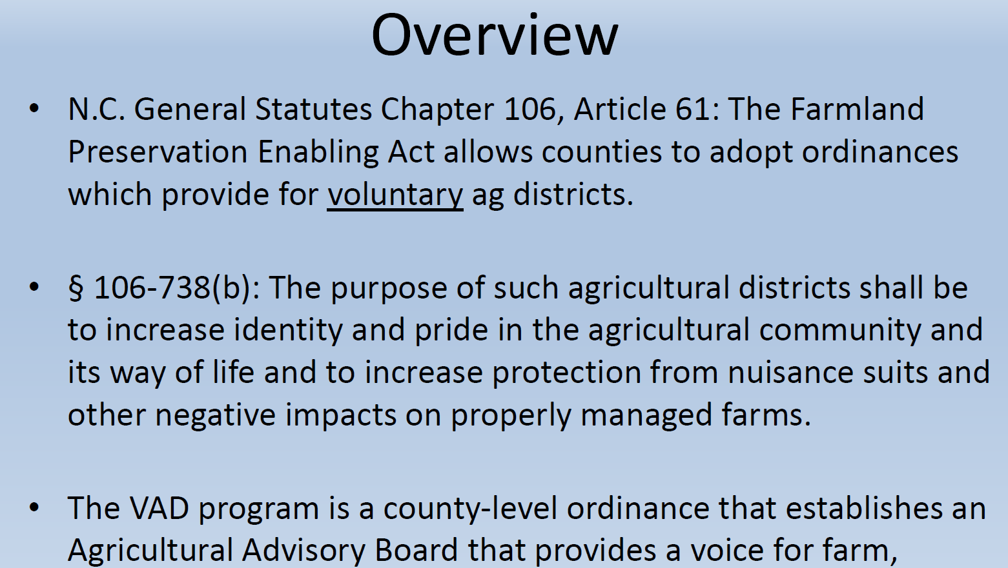
Other slide variations are available. Select Insert above and choose “new slide” to see all the options.

Slide 4
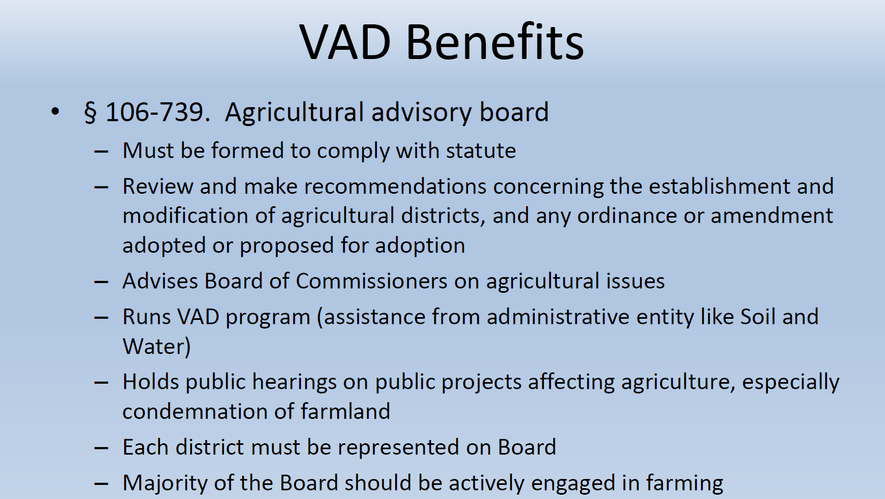
Other slide variations are available. Select Insert above and choose “new slide” to see all the options.

Slide 5
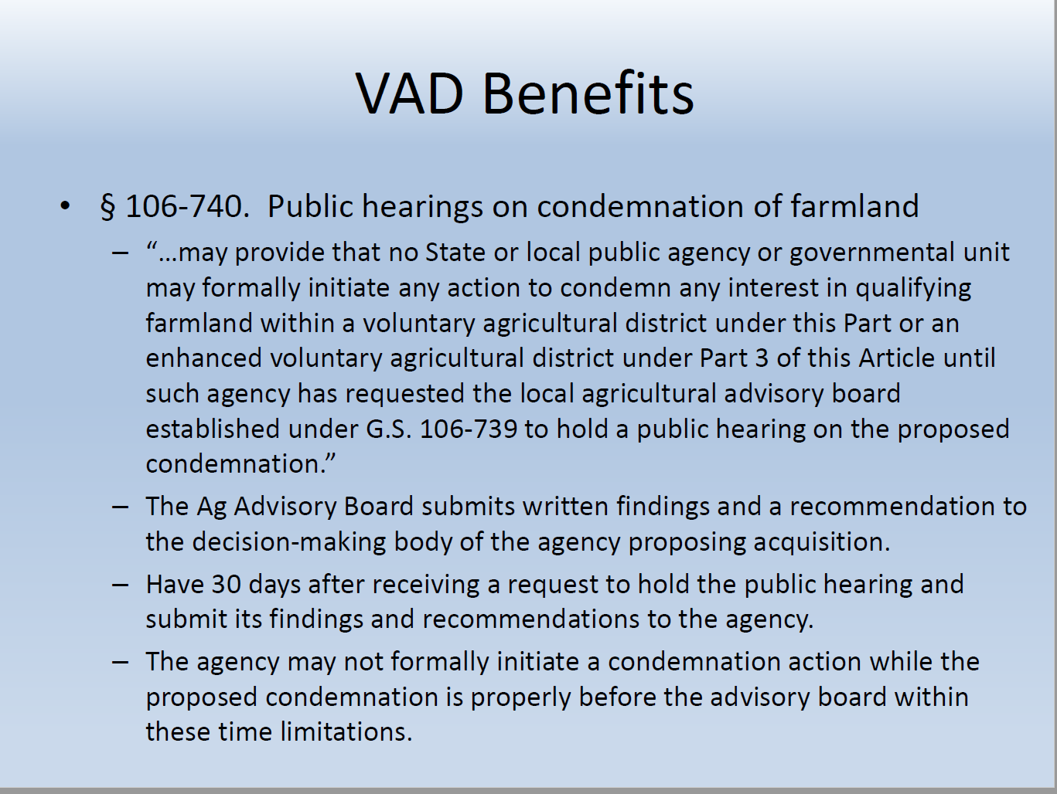
Other slide variations are available. Select Insert above and choose “new slide” to see all the options.
Notes:
Important to note that this is NOT a standard NCDOT public hearing. Notice that the wording is that we request the local advisory board to hold a public hearing.
Public Involvement and specifically Diane Wilson will assist with preparing a presentation.
At the hearing NCDOT had to address why we had filed condemnation on a parcel without meeting the requirements of the General Statute.
So let’s look at our process….

Slide 6
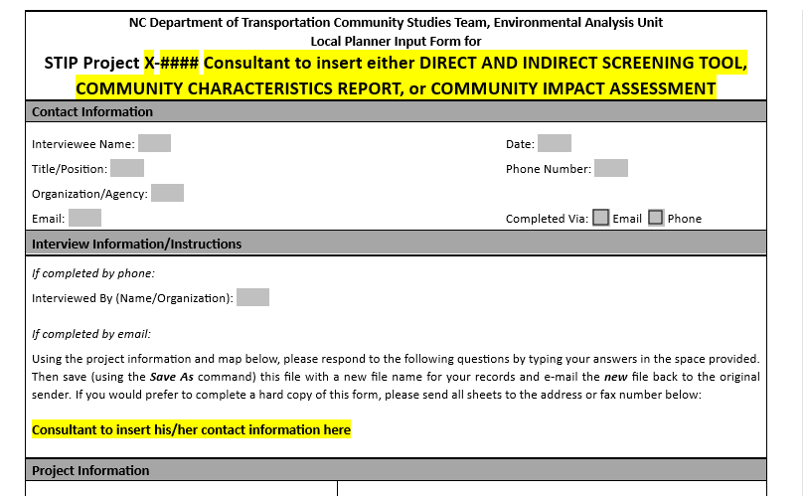
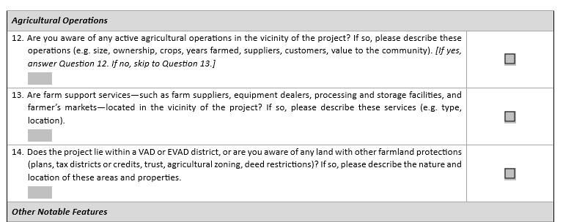
Other slide variations are available. Select Insert above and choose “new slide” to see all the options.
NCDOT Planning Touch Points - VAD
Notes:
Community Studies – local planner input form!

Slide 7
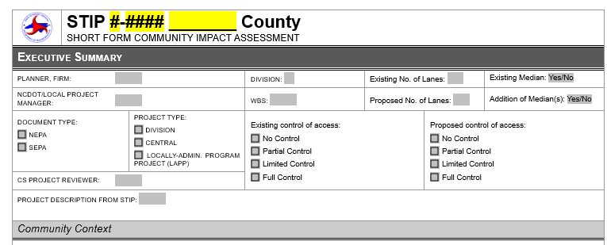
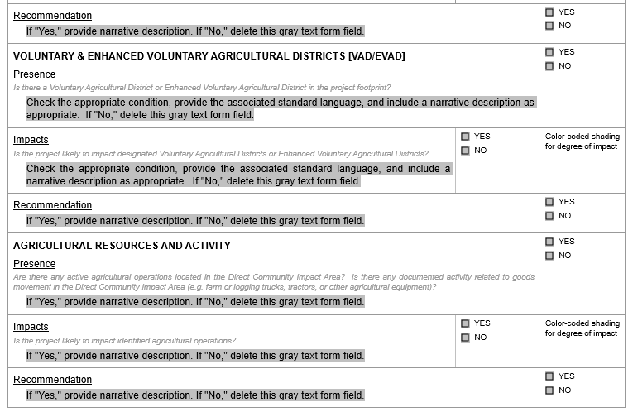
Other slide variations are available. Select Insert above and choose “new slide” to see all the options.
NCDOT Planning Touch Points - VAD
Notes:
Local planner input and/or data screening should be documented in the community impact assessment

Slide 8
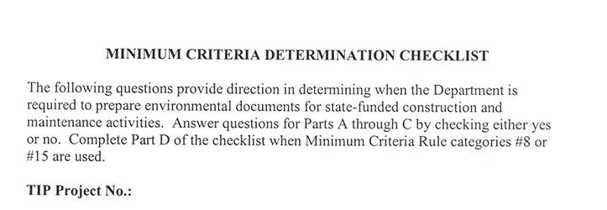
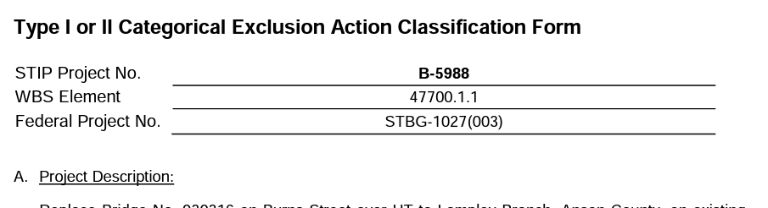
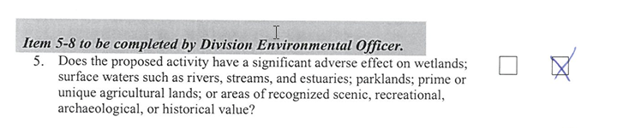
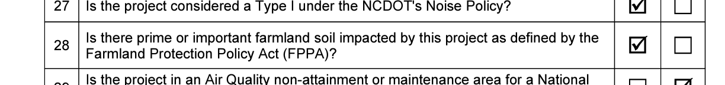
Other slide variations are available. Select Insert above and choose “new slide” to see all the options.
NCDOT Planning Touch Points - VAD
Notes:
Then that feeds into the environmental planning document
In the case of our project:
the local planner had not returned the form after several attempts
digital data/screening may not have been available at the time the document was done
therefore the environmental document did not flag and the hearing was never requested

Slide 9
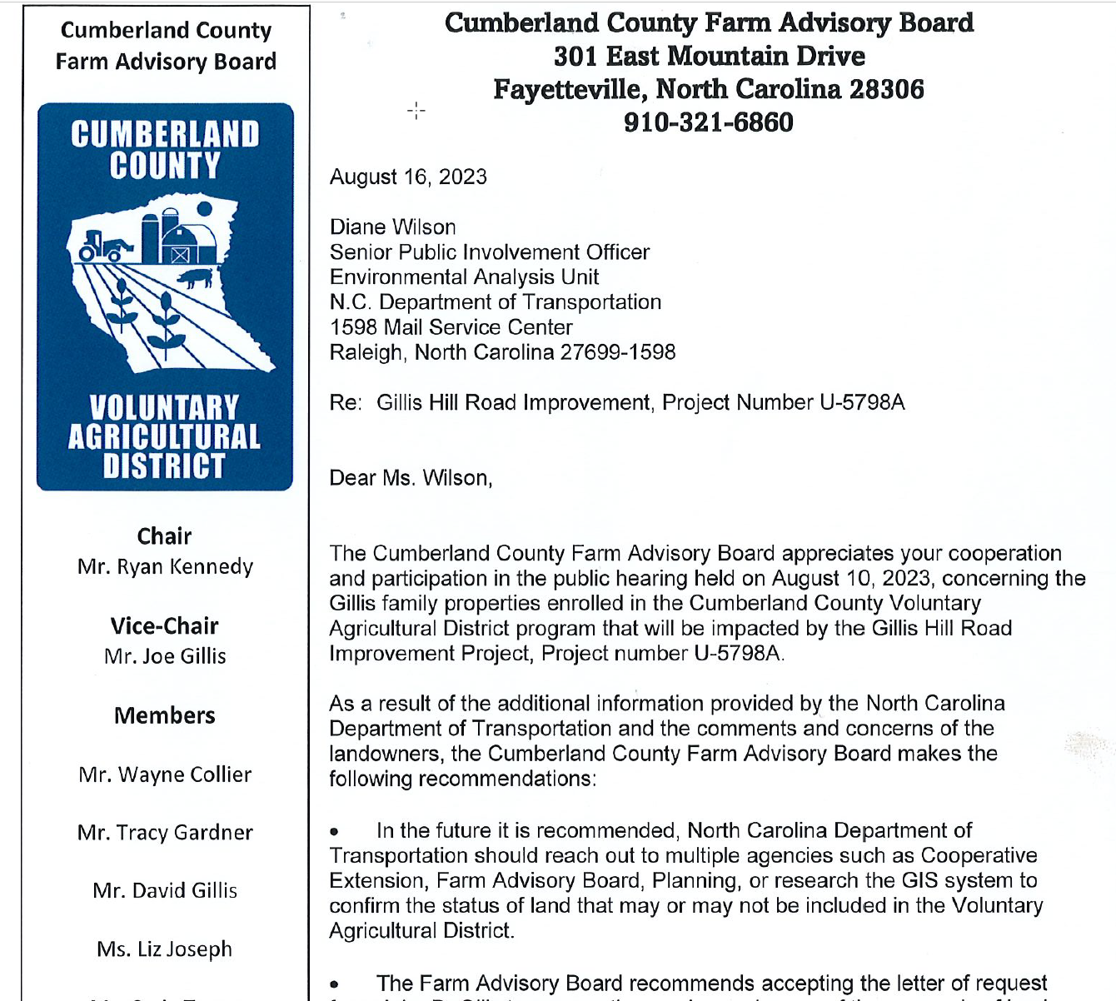
Other slide variations are available. Select Insert above and choose “new slide” to see all the options.
NCDOT Planning Touch Points - VAD
Notes:
In the case of our project the outcome was successful
However you can see the request was clear that we do better next time (and we were reminded of that in the hearing as well).
Leilani will show us the data that is available.
I would recommend screening projects that have older environmental documents and/or limited community studies work done to ensure we flag VAD parcels to maintain compliance with GS.

Slide 10
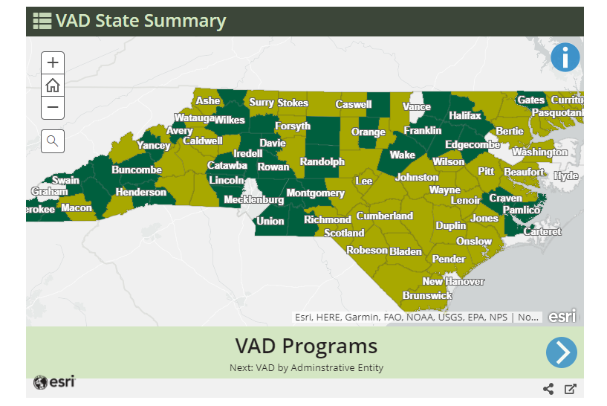
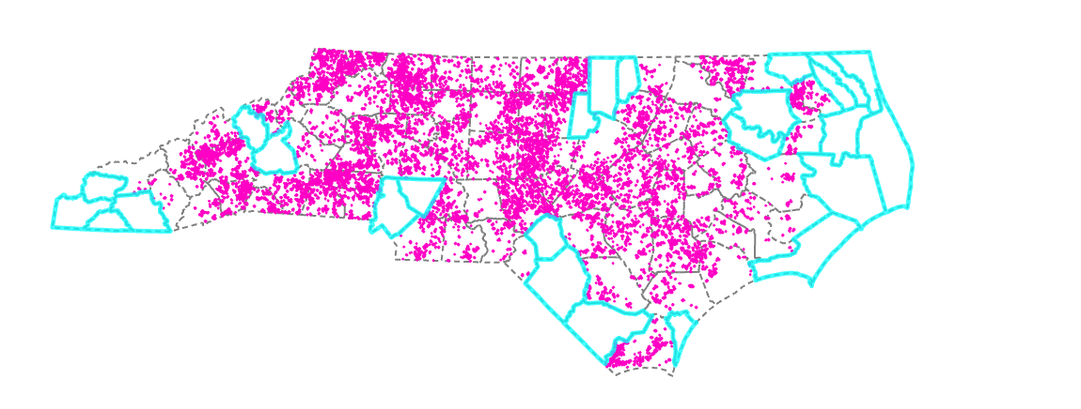
Statewide VAD Layer
Department of Agriculture VAD Ordinance Presence
County VAD Spatial Data

Slide 11
Data Issues
Statewide VAD Layer
91 Counties with VAD Ordinance
75 of the 91 Counties have VAD Spatial Data available
16 of the 91 Counties do not have VAD Spatial Data available
~60 Counties with County Spatial Data that are unreliable

Slide 12
16 Counties without VAD Spatial Data
Statewide VAD Layer
VAD Ordinance | VAD Data Presence | County
VAD | No | Bertie
EVAD | No | Cabarrus
VAD | No | Camden
EVAD | No | Cherokee
EVAD | No | Clay
VAD | No | Columbus
VAD | No | Currituck
VAD | No | Durham
EVAD | No | Gates
VAD | No | Granville
VAD | No | Hoke
VAD | No | Macon
VAD | No | McDowell
VAD | No | Pasquotank
VAD | No | Robeson
EVAD | No | Yancey

Slide 13
Data Reliability and Unknowns
Statewide VAD Layer
We are coordinating with Dept of Agriculture and Counties to address issues
Published GIS data has errors/omissions/no symbology
Statewide Map updated only one time a year via a voluntary survey
No established procedures for publishing County VAD spatial data
Update occurrences and schedule unknown

Slide 14
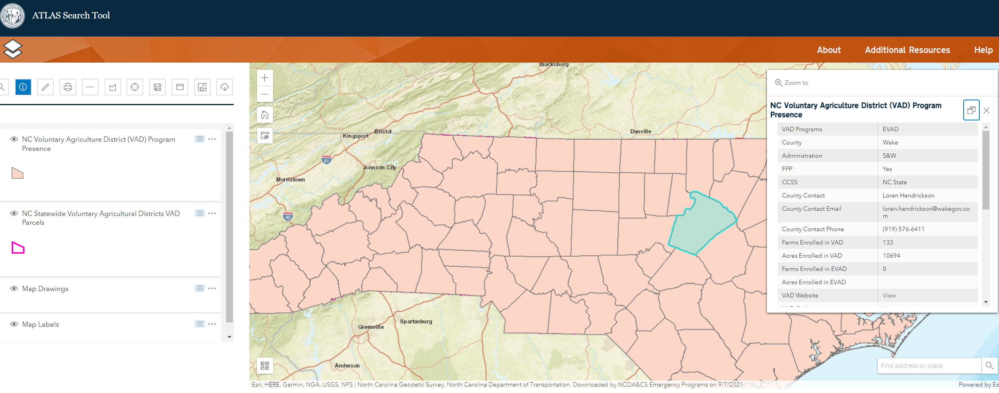
ATLAS Search
Statewide VAD Layer

Slide 15
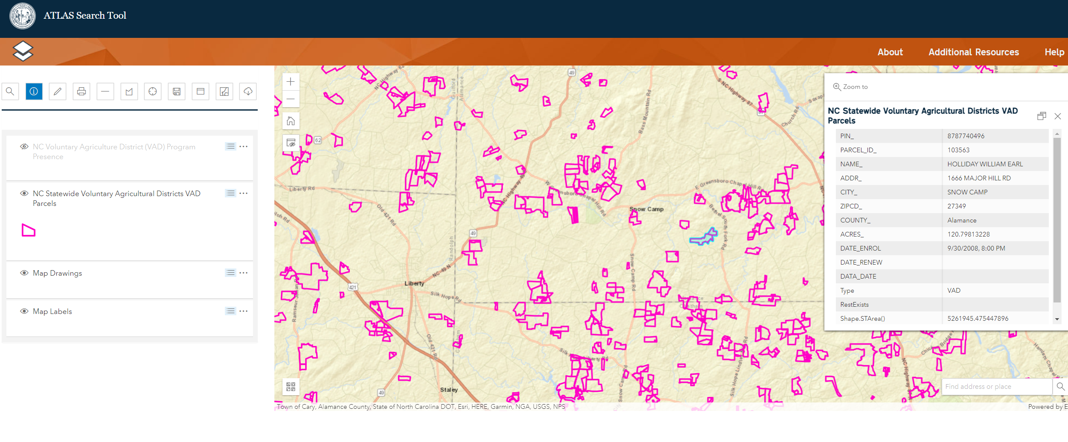
ATLAS Search
Statewide VAD Layer

Slide 16
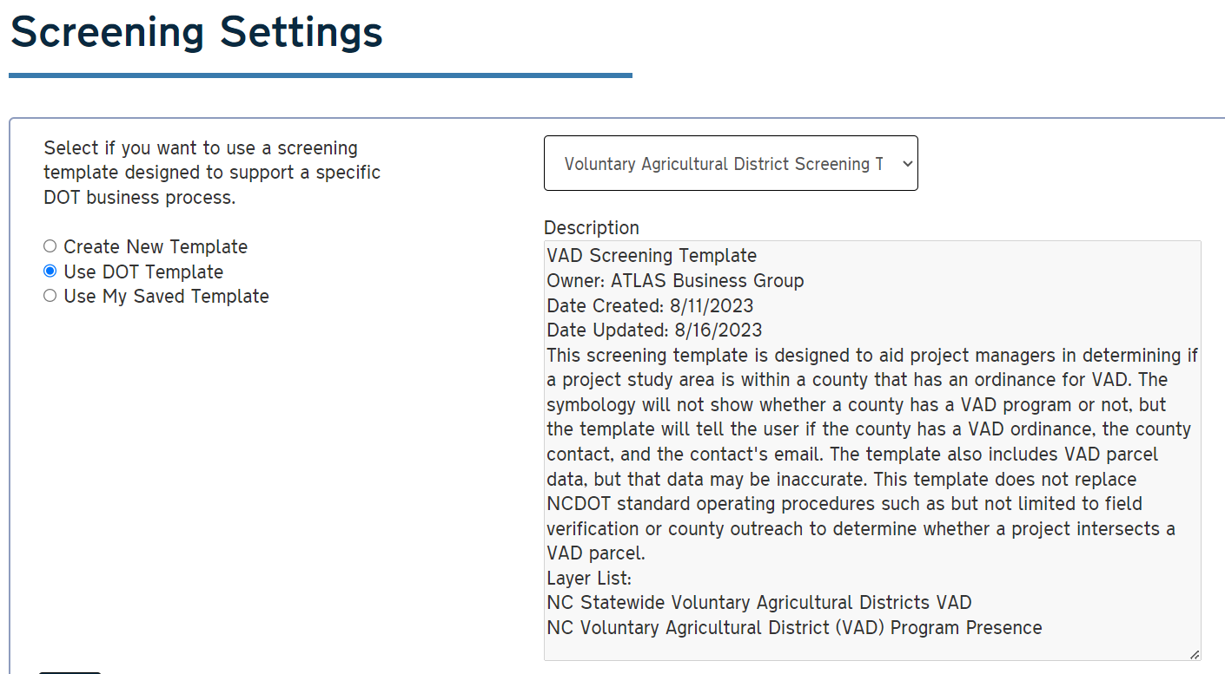
ATLAS Screening
Statewide VAD Layer

Slide 17
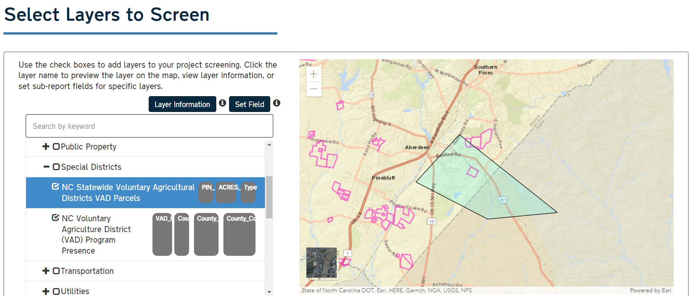
ATLAS Screening
Statewide VAD Layer

Slide 18
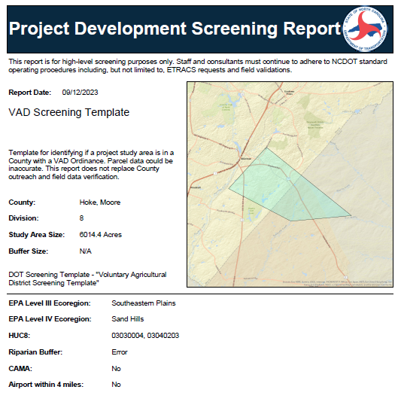
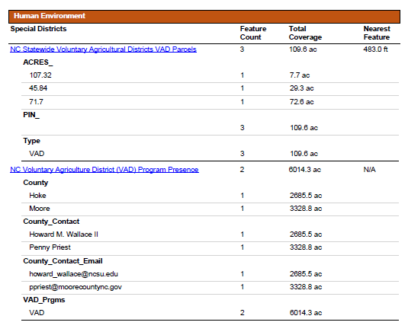
ATLAS Screening
Statewide VAD Layer

Slide 19
Other slide variations are available. Select Insert above and choose “new slide” to see all the options.

